Slide 1


Project 2
TRADE TITAN ADVISOR
Tej + Kay + Renee + Owen

Slide 2




STOCK RETURNS
&
TRADING STRATEGIES

Slide 3






META
BUSINESS PREVIEW
DATA SOURCE
Yahoo Finance
MISSION DESCRIPTION
TIME PERIOD
Stock Returns + Trading Strategies via Machine Learning
2012/05 - 2023/12

Slide 4


05
TECHNICAL ANALYSIS + MACHINE LEARNING (MA)
Exploring technical indicators, and adopt machine learning via moving averages
LIST OF CONTENT
12
MACHINE LEARNING 1
Use the Baseline Trading Algorithm & Logistic Regression to explore the best model to test
15
MACHINE LEARNING 2
Use MLP Methodology to further develop
20
TRADE TITAN ADVISER
Demo by Kay

Slide 5


TECHNICAL ANALYSIS
WHAT IS EXPLORED?
Technical Indicator
Simple Moving Average - Average over specific period
Exponential Moving Average - Weighted towards Recent Data
Smoothed Simple Moving Average - Combination of SMA and EMA
Volume Adjusted Moving Average - Weighted towards Heavier Volume
Bollinger Bands - Volatility Indicator
2. SVM
HOW DOES THE T.I. TRANSLATE INTO A TRADING STRATEGY?
TWO MOVING AVERAGES WHOSE CROSS-OVER WITH DAILY CLOSE PRICES DETERMINE THE SIGNAL TO ENTER OR EXIT THE POSITION
Notes:
SMA: The SMA helps identify trends but can be slower in recognizing changes since it considers an equal weight for all data points.
The SMA is commonly used as a benchmark for other types of moving averages. It is suitable for long-term trend analysis.
EMA: The EMA responds quickly to price changes, making it beneficial for trend identification and capturing emerging trends.The EMA is popular among traders who require faster trend identification and wish to capture recent price changes.
SMMA: The SMMA reduces noise and provides a clearer representation of the underlying trend.
The SMMA is useful for smoothing out price data and reducing noise, offering a clearer view of the overall trend.

Slide 6
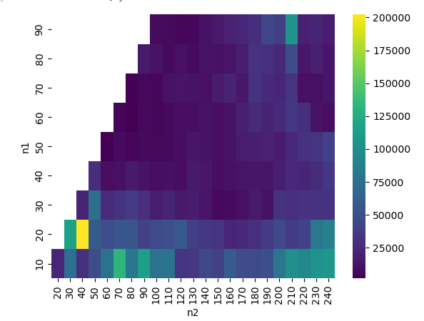
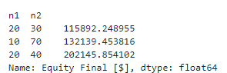
BACKTESTING - SELECTION OF ROLLING WINDOWS
THIS HEATMAP CONTAINS THE RESULTS OF ALL THE RUNS, MAKING IT VERY EASY TO OBTAIN PARAMETER COMBINATIONS.
TOP 3 COMBINATIONS THAT PERFORMS BEST.

Slide 7
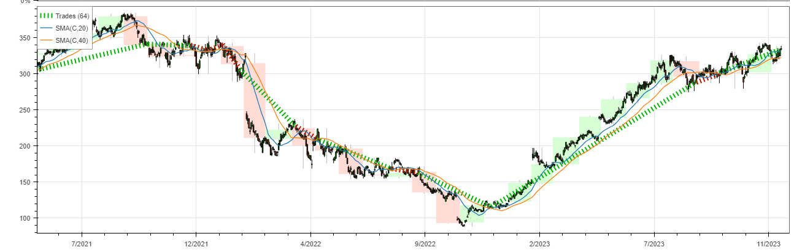
SMA PRICING TRENDS UNDER OPTIMISED ROLLING WINDOW
SHORT/ FAST WINDOW (N1) = 20
LONG/ SLOW WINDOW (N2) = 40
Notes:
Volatility Identification: Bollinger Bands expand and contract based on the volatility of the price. Wider bands indicate higher volatility, while narrower bands suggest lower volatility.
Overbought and Oversold Conditions: When the price touches or exceeds the upper band, it may indicate that the market is overbought, and a reversal or pullback could occur. Conversely, when the price reaches or falls below the lower band, it may suggest oversold conditions, and a potential upward correction might be expected.
Trend Confirmation: The position of the price relative to the bands can be used to confirm the direction of the trend. In an uptrend, prices tend to stay near the upper band, and in a downtrend, prices may hover around the lower band.
Price Reversion: Traders often use Bollinger Bands to identify potential reversal points or areas where prices are likely to revert to the mean (middle band).
Breakout Signals: Sharp price movements that breach the upper or lower bands can signal potential breakout opportunities, indicating a strong bullish or bearish momentum.

Slide 8

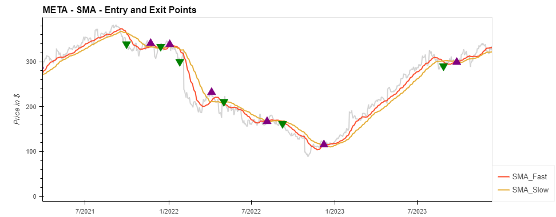
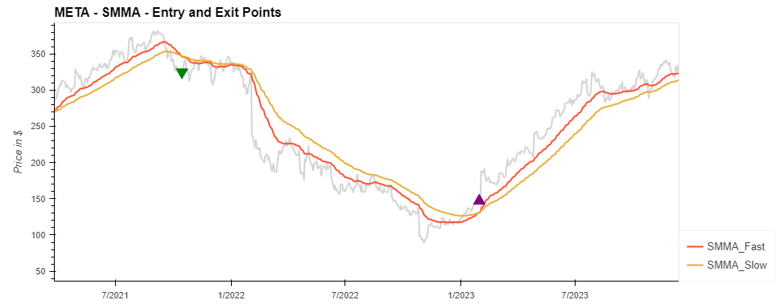
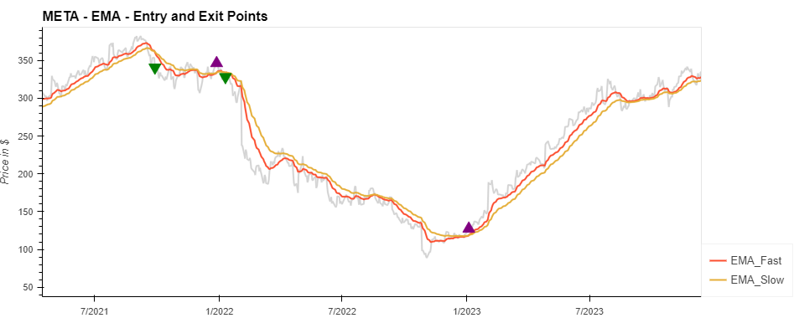
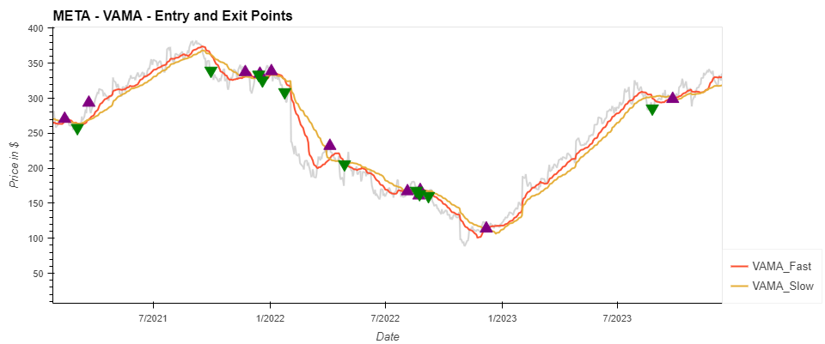
TECHNICAL INDICATORS - MOVING AVERAGES
BUY
SELL
- CROSSOVER BETWEEN FAST & SLOW
Notes:
SMA: The SMA helps identify trends but can be slower in recognizing changes since it considers an equal weight for all data points.
The SMA is commonly used as a benchmark for other types of moving averages. It is suitable for long-term trend analysis.
EMA: The EMA responds quickly to price changes, making it beneficial for trend identification and capturing emerging trends.The EMA is popular among traders who require faster trend identification and wish to capture recent price changes.
SMMA: The SMMA reduces noise and provides a clearer representation of the underlying trend.
The SMMA is useful for smoothing out price data and reducing noise, offering a clearer view of the overall trend.

Slide 9
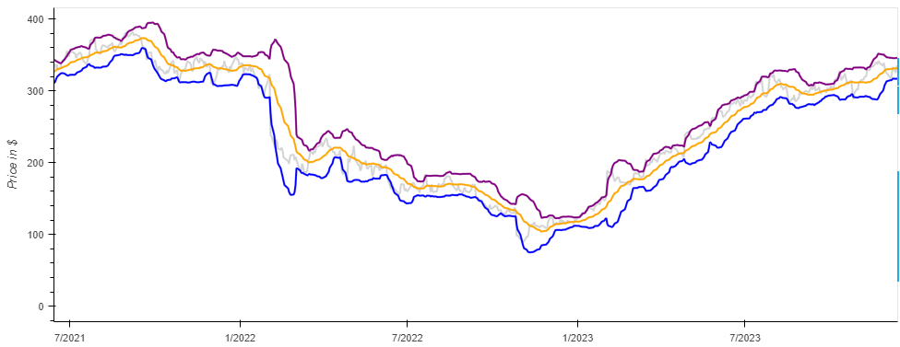
TECHNICAL INDICATOR - BOLLINGER BANDS
THE POSITION OF THE PRICE RELATIVE TO THE BANDS CAN BE USED TO CONFIRM THE DIRECTION OF THE TREND.
TO IDENTIFY POTENTIAL REVERSAL POINTS OR AREAS WHERE PRICES ARE LIKELY TO REVERT TO THE MEAN (MIDDLE BAND).
OVERBOUGHT MARKET CONDITIONS
HIGHER VOLATILITY
LOWER VOLATILITY
OVERSOLD MARKET CONDITIONS
Notes:
Volatility Identification: Bollinger Bands expand and contract based on the volatility of the price. Wider bands indicate higher volatility, while narrower bands suggest lower volatility.
Overbought and Oversold Conditions: When the price touches or exceeds the upper band, it may indicate that the market is overbought, and a reversal or pullback could occur. Conversely, when the price reaches or falls below the lower band, it may suggest oversold conditions, and a potential upward correction might be expected.
Trend Confirmation: The position of the price relative to the bands can be used to confirm the direction of the trend. In an uptrend, prices tend to stay near the upper band, and in a downtrend, prices may hover around the lower band.
Price Reversion: Traders often use Bollinger Bands to identify potential reversal points or areas where prices are likely to revert to the mean (middle band).
Breakout Signals: Sharp price movements that breach the upper or lower bands can signal potential breakout opportunities, indicating a strong bullish or bearish momentum.

Slide 10
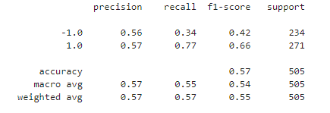
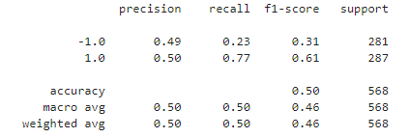
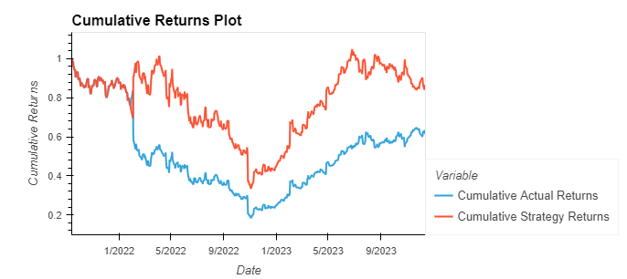
INDICATORS VIA MACHINE LEARNING (SVM)
TRAINING SET - 2016 -2019
TESTING SET - 2019 - 2023
CUMULATIVE STRATEGY RETURNS IS ABOVE CUMULATIVE ACTUAL RETURNS
Notes:
Volatility Identification: Bollinger Bands expand and contract based on the volatility of the price. Wider bands indicate higher volatility, while narrower bands suggest lower volatility.
Overbought and Oversold Conditions: When the price touches or exceeds the upper band, it may indicate that the market is overbought, and a reversal or pullback could occur. Conversely, when the price reaches or falls below the lower band, it may suggest oversold conditions, and a potential upward correction might be expected.
Trend Confirmation: The position of the price relative to the bands can be used to confirm the direction of the trend. In an uptrend, prices tend to stay near the upper band, and in a downtrend, prices may hover around the lower band.
Price Reversion: Traders often use Bollinger Bands to identify potential reversal points or areas where prices are likely to revert to the mean (middle band).
Breakout Signals: Sharp price movements that breach the upper or lower bands can signal potential breakout opportunities, indicating a strong bullish or bearish momentum.

Slide 11
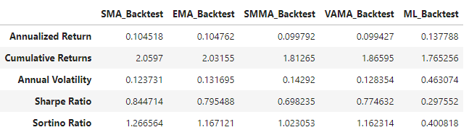
PERFORMANCE METRIC COMPARISONS
PERFORMANCE METRIC ACROSS INDICATORS AMONGST TECHNICAL ANALYSIS + MACHINE LEARNING (FINAL)
Notes:
Volatility Identification: Bollinger Bands expand and contract based on the volatility of the price. Wider bands indicate higher volatility, while narrower bands suggest lower volatility.
Overbought and Oversold Conditions: When the price touches or exceeds the upper band, it may indicate that the market is overbought, and a reversal or pullback could occur. Conversely, when the price reaches or falls below the lower band, it may suggest oversold conditions, and a potential upward correction might be expected.
Trend Confirmation: The position of the price relative to the bands can be used to confirm the direction of the trend. In an uptrend, prices tend to stay near the upper band, and in a downtrend, prices may hover around the lower band.
Price Reversion: Traders often use Bollinger Bands to identify potential reversal points or areas where prices are likely to revert to the mean (middle band).
Breakout Signals: Sharp price movements that breach the upper or lower bands can signal potential breakout opportunities, indicating a strong bullish or bearish momentum.

Slide 12
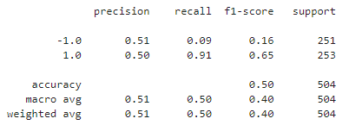
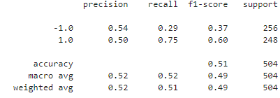
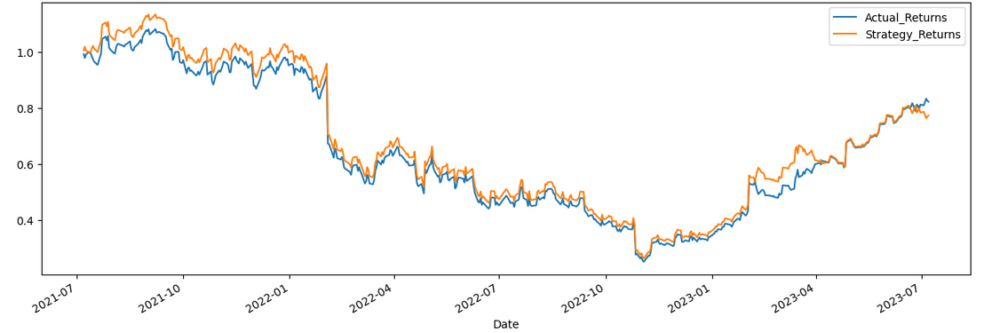
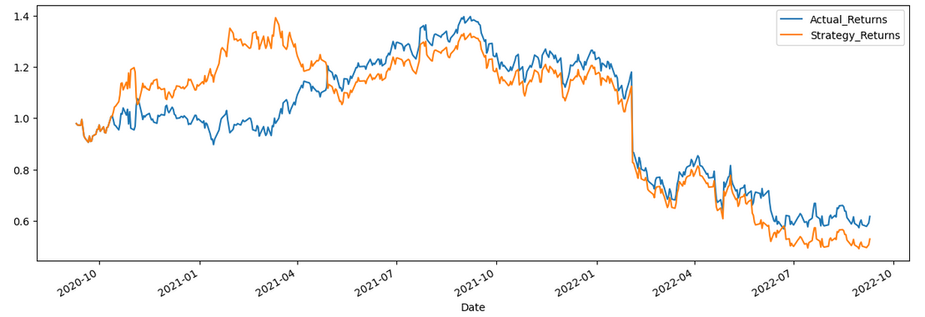
MACHINE LEARNING-BASELINE TRADING ALGORITHM
1000 DAYS
700 DAYS
Notes:
Volatility Identification: Bollinger Bands expand and contract based on the volatility of the price. Wider bands indicate higher volatility, while narrower bands suggest lower volatility.
Overbought and Oversold Conditions: When the price touches or exceeds the upper band, it may indicate that the market is overbought, and a reversal or pullback could occur. Conversely, when the price reaches or falls below the lower band, it may suggest oversold conditions, and a potential upward correction might be expected.
Trend Confirmation: The position of the price relative to the bands can be used to confirm the direction of the trend. In an uptrend, prices tend to stay near the upper band, and in a downtrend, prices may hover around the lower band.
Price Reversion: Traders often use Bollinger Bands to identify potential reversal points or areas where prices are likely to revert to the mean (middle band).
Breakout Signals: Sharp price movements that breach the upper or lower bands can signal potential breakout opportunities, indicating a strong bullish or bearish momentum.

Slide 13
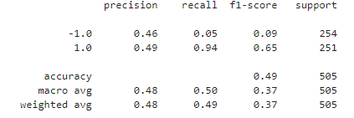
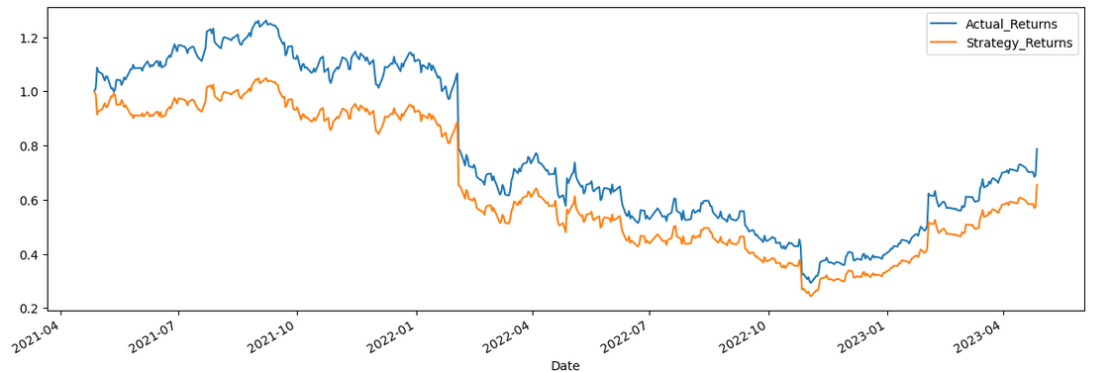
MACHINE LEARNING-BASELINE TRADING ALGORITHM
SHORT WINDOW 4
LONG WINDOW 100
SHORT WINDOW 8
Long wINDOW 50
Notes:
Volatility Identification: Bollinger Bands expand and contract based on the volatility of the price. Wider bands indicate higher volatility, while narrower bands suggest lower volatility.
Overbought and Oversold Conditions: When the price touches or exceeds the upper band, it may indicate that the market is overbought, and a reversal or pullback could occur. Conversely, when the price reaches or falls below the lower band, it may suggest oversold conditions, and a potential upward correction might be expected.
Trend Confirmation: The position of the price relative to the bands can be used to confirm the direction of the trend. In an uptrend, prices tend to stay near the upper band, and in a downtrend, prices may hover around the lower band.
Price Reversion: Traders often use Bollinger Bands to identify potential reversal points or areas where prices are likely to revert to the mean (middle band).
Breakout Signals: Sharp price movements that breach the upper or lower bands can signal potential breakout opportunities, indicating a strong bullish or bearish momentum.

Slide 14
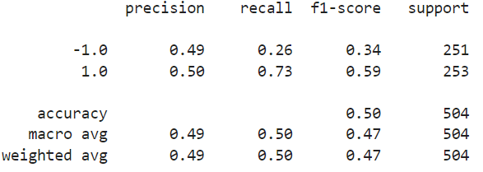
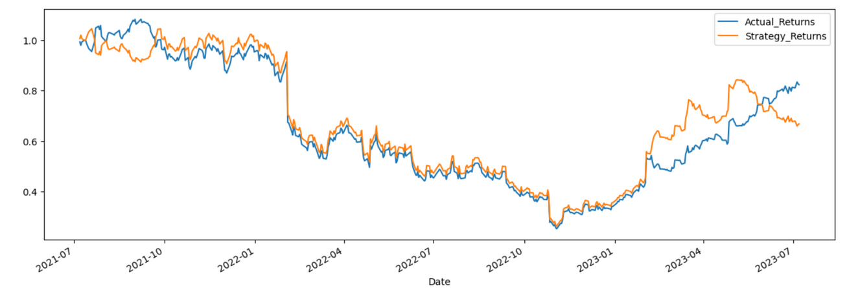
LOGISTIC REGRESSIONA
1000 DAYS SHORT WINDOW 4 LONG WINDOW 100
Notes:
Volatility Identification: Bollinger Bands expand and contract based on the volatility of the price. Wider bands indicate higher volatility, while narrower bands suggest lower volatility.
Overbought and Oversold Conditions: When the price touches or exceeds the upper band, it may indicate that the market is overbought, and a reversal or pullback could occur. Conversely, when the price reaches or falls below the lower band, it may suggest oversold conditions, and a potential upward correction might be expected.
Trend Confirmation: The position of the price relative to the bands can be used to confirm the direction of the trend. In an uptrend, prices tend to stay near the upper band, and in a downtrend, prices may hover around the lower band.
Price Reversion: Traders often use Bollinger Bands to identify potential reversal points or areas where prices are likely to revert to the mean (middle band).
Breakout Signals: Sharp price movements that breach the upper or lower bands can signal potential breakout opportunities, indicating a strong bullish or bearish momentum.

Slide 15

MLP- METHODOLOGY
Import ‘MLPClassifier’ from SKLearn
Initialise the MLPClassifier with the following parameters:
solver
regularisation
hidden layer sizes
fixed random state
MLPClassifier with SGD solver, regularization alpha, two hidden layers of 12 and 8 neurons, and a fixed random state for reproducibility.

Slide 16
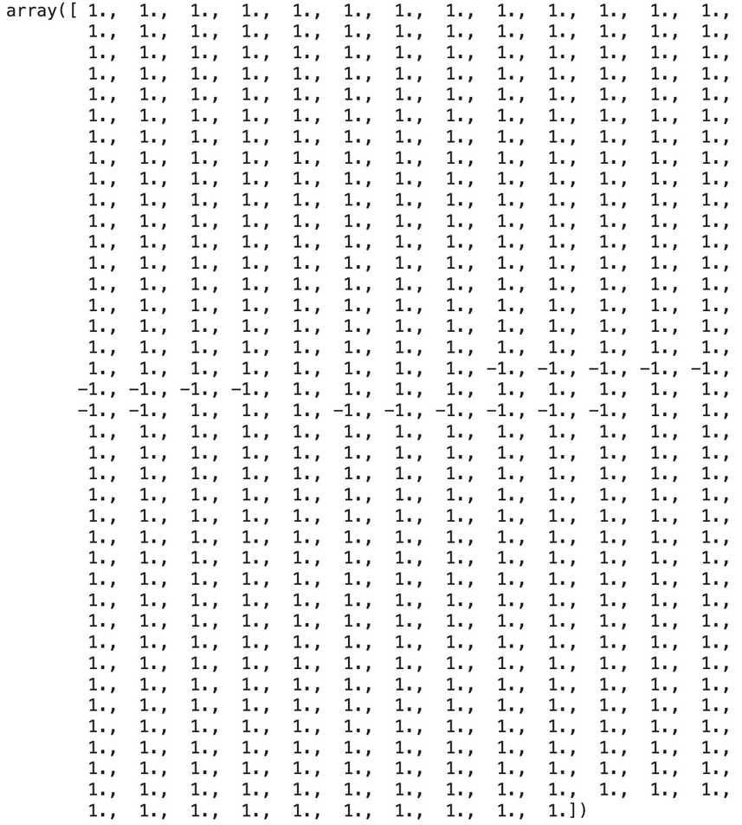

MODEL FITTING AND PREDICTIONS
Train the MLPClassifier model (clf) using the scaled training data (X_train_scaled) and corresponding labels (y_train)
Use the trained MLPClassifier model (MLP_model) to predict outcomes for the scaled testing dataset (X_test_scaled)
Notes:
Volatility Identification: Bollinger Bands expand and contract based on the volatility of the price. Wider bands indicate higher volatility, while narrower bands suggest lower volatility.
Overbought and Oversold Conditions: When the price touches or exceeds the upper band, it may indicate that the market is overbought, and a reversal or pullback could occur. Conversely, when the price reaches or falls below the lower band, it may suggest oversold conditions, and a potential upward correction might be expected.
Trend Confirmation: The position of the price relative to the bands can be used to confirm the direction of the trend. In an uptrend, prices tend to stay near the upper band, and in a downtrend, prices may hover around the lower band.
Price Reversion: Traders often use Bollinger Bands to identify potential reversal points or areas where prices are likely to revert to the mean (middle band).
Breakout Signals: Sharp price movements that breach the upper or lower bands can signal potential breakout opportunities, indicating a strong bullish or bearish momentum.

Slide 17
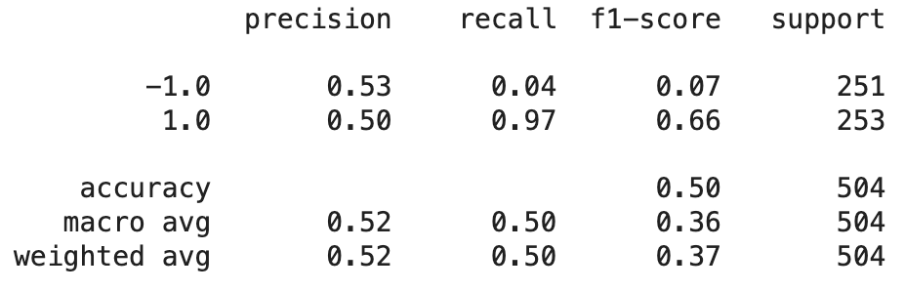
CLASSIFICATION REPORT
Generating a classification report (MLP_testing_report) by comparing the predicted outcomes (MLP_pred) against the actual labels (y_test) for evaluation of the MLP model's performance on the test data.

Slide 18
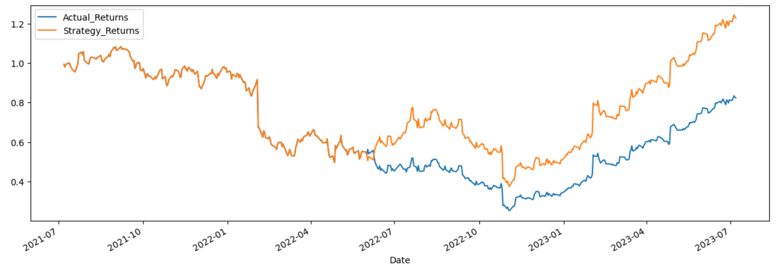
PLOT : ACTUAL RETURNS VS STRATEGY RETURNS
Visualisation of the cumulative compounded returns of 'Actual_Returns' and 'Strategy_Returns' columns using a plot with specified dimensions.
Notes:
Volatility Identification: Bollinger Bands expand and contract based on the volatility of the price. Wider bands indicate higher volatility, while narrower bands suggest lower volatility.
Overbought and Oversold Conditions: When the price touches or exceeds the upper band, it may indicate that the market is overbought, and a reversal or pullback could occur. Conversely, when the price reaches or falls below the lower band, it may suggest oversold conditions, and a potential upward correction might be expected.
Trend Confirmation: The position of the price relative to the bands can be used to confirm the direction of the trend. In an uptrend, prices tend to stay near the upper band, and in a downtrend, prices may hover around the lower band.
Price Reversion: Traders often use Bollinger Bands to identify potential reversal points or areas where prices are likely to revert to the mean (middle band).
Breakout Signals: Sharp price movements that breach the upper or lower bands can signal potential breakout opportunities, indicating a strong bullish or bearish momentum.

Slide 19




STRATEGY CONCLUSIONS
STEP ONE
Technical Indicators - Crossover Strategy
SVM Machine Learning Model + Technical Analysis
STEP TWO
Alternate Machine Learning Models
Logistic Regression
Multiple Layer Perceptron
OUR FINAL SELECTION OF TRADING MODEL:
MACHINE LEARNING - MLP

Slide 20




DEMONSTRATION
TRADE TITEN - MADE BY KAY
Problem solved

Slide 21
THANKS

